Slide 1
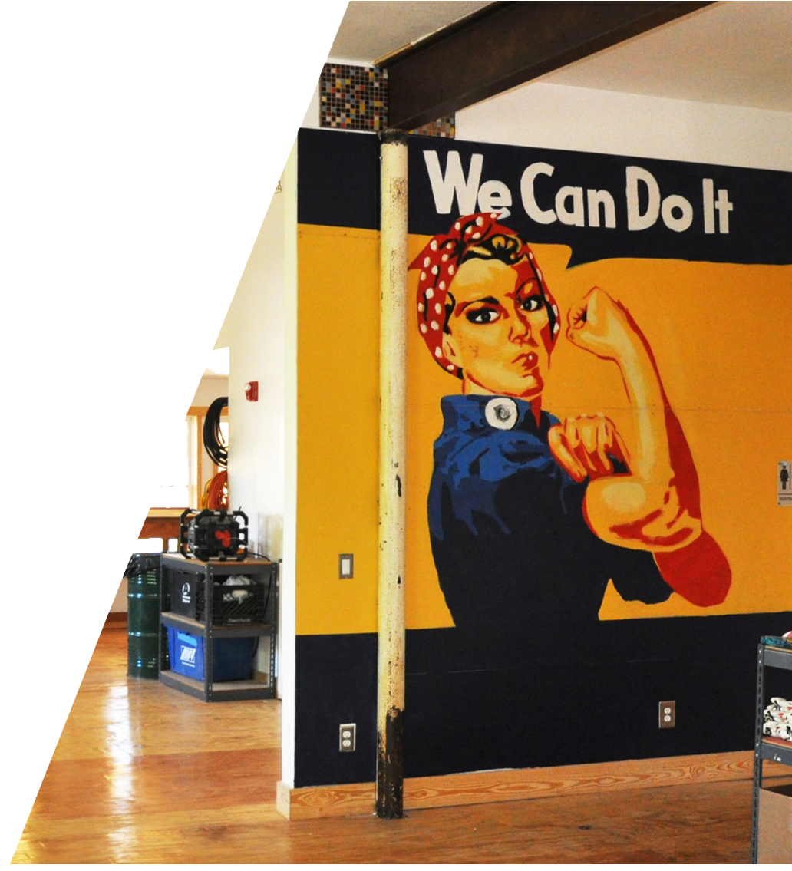
PROGRAM OVERVIEW
V1.2021

Slide 2
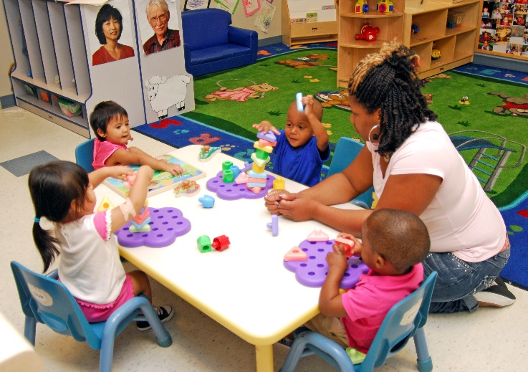
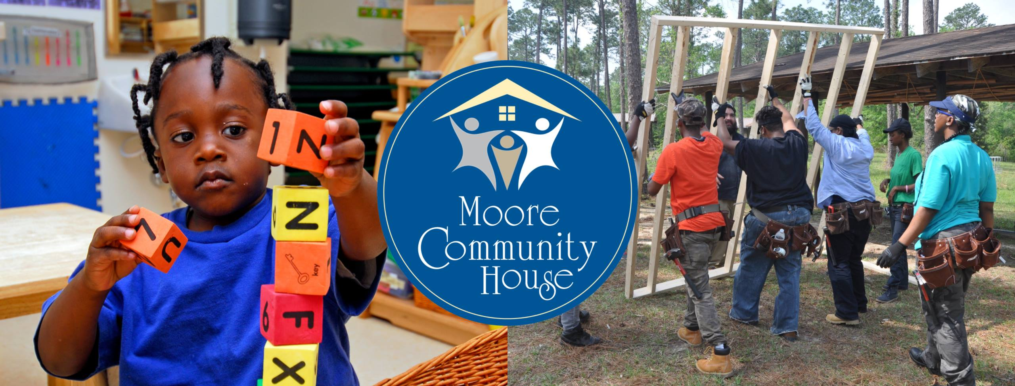
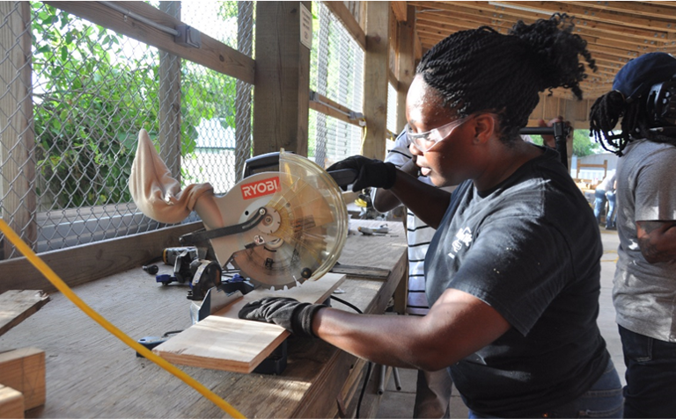
WHO WE ARE
Program of Moore Community House (MCH) in East Biloxi
MCH has been serving families since 1924
MCH Early Head Start program serves pregnant women, infants, and toddlers up to 3 years old
MCH Women in Construction (WinC) trains women for high-wage, high-demand construction and skilled craft trade careers

Slide 3
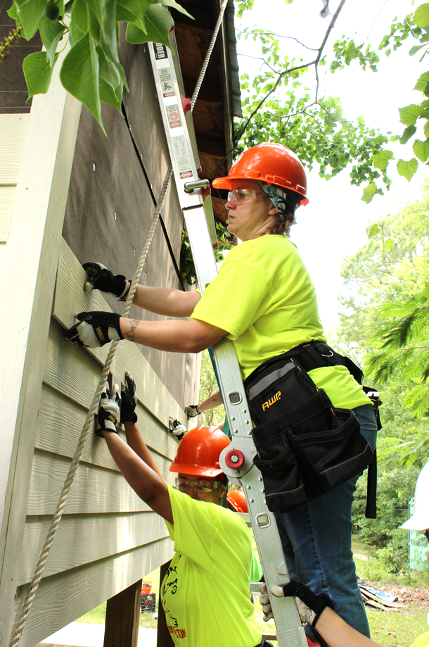
WOMEN IN MISSISSIPPI
In Mississippi, women make up half of the workforce, yet 2/3 of the minimum wage earners.
75% of single moms in Mississippi are in the workforce, but most are stuck in low-wage jobs, leaving families in poverty.
Higher paying work for women generally means non-traditional occupations in which women are drastically underrepresented, but better paid.
Moore Community House Women in Construction builds a pathway to trades careers for women.

Slide 4
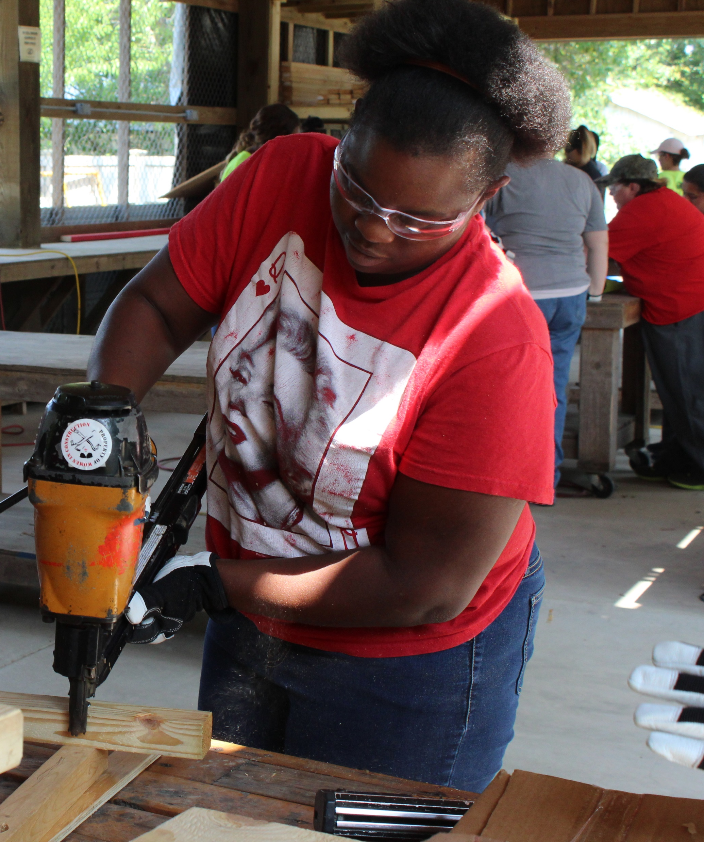
DEMOGRAPHICS OF WOMEN SERVED
Black / African American | 52.89%
White | 25.39%
Hispanic / Latina | 16.02%
More than one race | 3.15%
Did not Identify | 1.31%
American Indian / Native Alaskan | 0.53%
Asian | 0.36%
Native Hawaiian / Pacific Islander | 0.35%

Slide 5
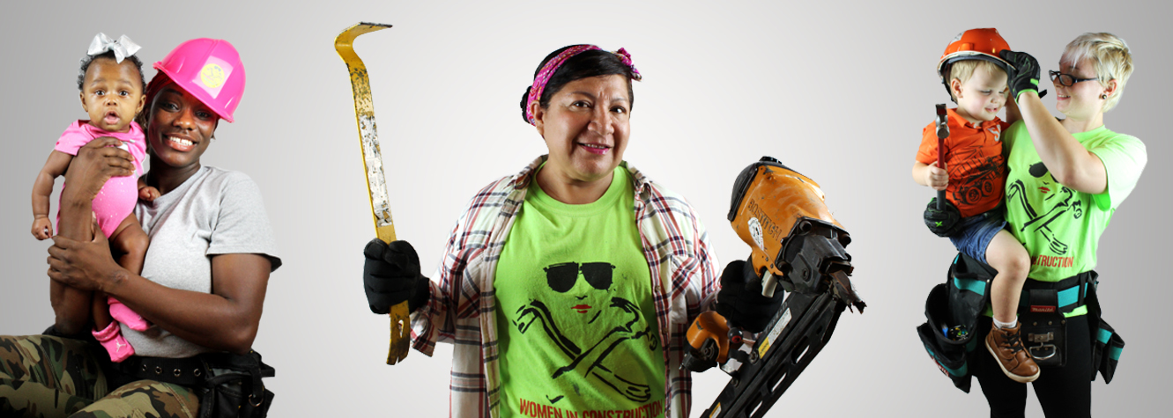
OUR MISSION
To increase the earning power of women and strengthen their ability to provide for their families by equipping them with training and employability skills required for entering a non-traditional occupation, while also developing leadership skills.

Slide 6
THE TRADES
Career | Starting Pay
Welders | $19.00 hourly
Electricians | $22.68 hourly
Carpenters | $19.98 hourly
Cement Masons | $17.04 hourly
Concrete Finishers | $17.04 hourly
HVAC Technician | $19.76 hourly
General Laborers | $12.17 hourly
Trade careers can include:
Electricians, Welders, Plumbers, Pipefitters, Carpenters, Laborers, Equipment Operators, Bricklayers, Painters, Ironworkers, Elevator Installers and Repairers, Safety Inspectors, Plant Operators, Lighting and Production for movie and music sets
These are just a few of the trade careers available; they all pay more than most traditional occupations for women and provide better benefits

Slide 7
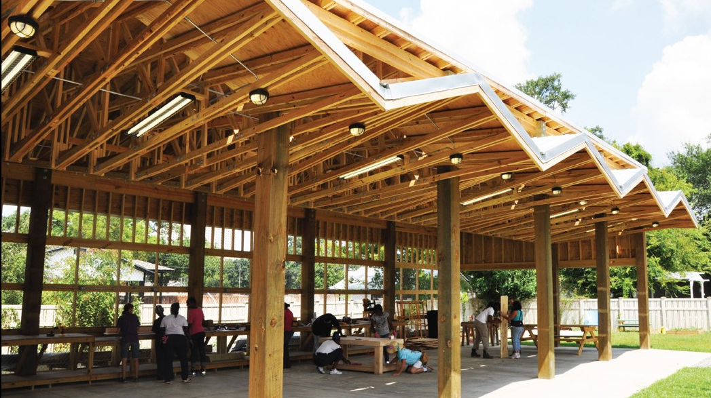
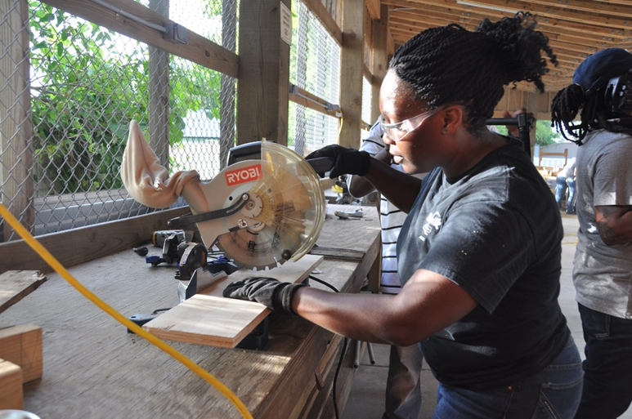
WHAT WINC OFFERS
Classroom and hands-on curriculum
Nationally recognized, stackable credentials
Safety credentials
Supplemental curriculum
Case management and supportive services

Slide 8
SUPPORTIVE SERVICES
Comprehensive Case Management
Stipend while enrolled
Assistance with PPE, tools, gear required for training and/or
employment
Childcare
Eligible participants of General Industry classes may receive up to 6 months of childcare assistance, as funding is available
Ongoing support network

Slide 9
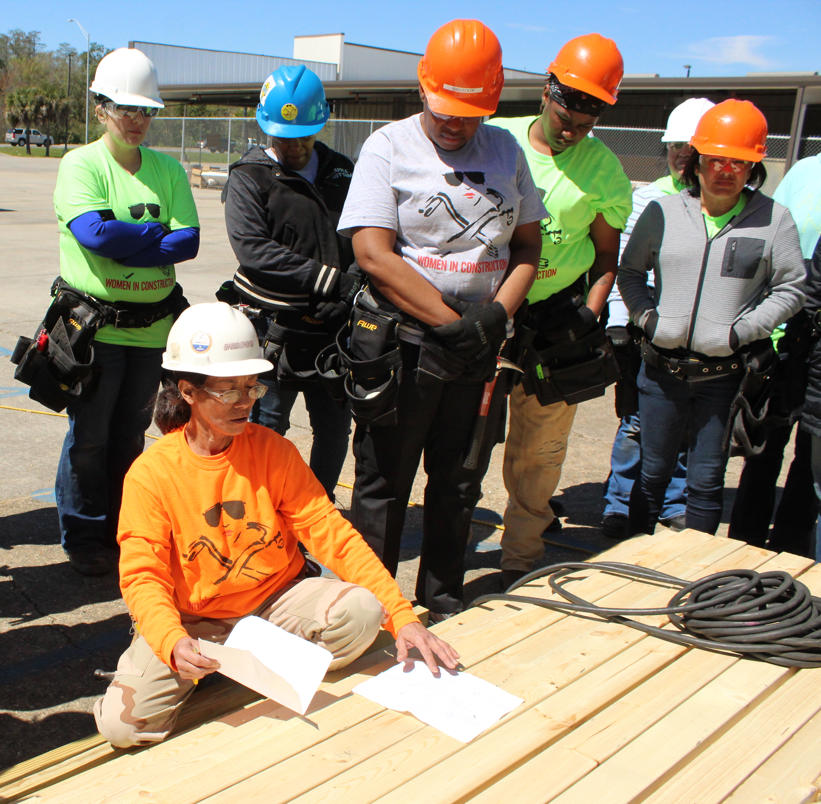
WINC CLASSES
Women in Trades 101
General Industry Pre-apprenticeship
Approved Partner Training
Advanced Leadership
All classes are offered at
no cost to participants.

Slide 10
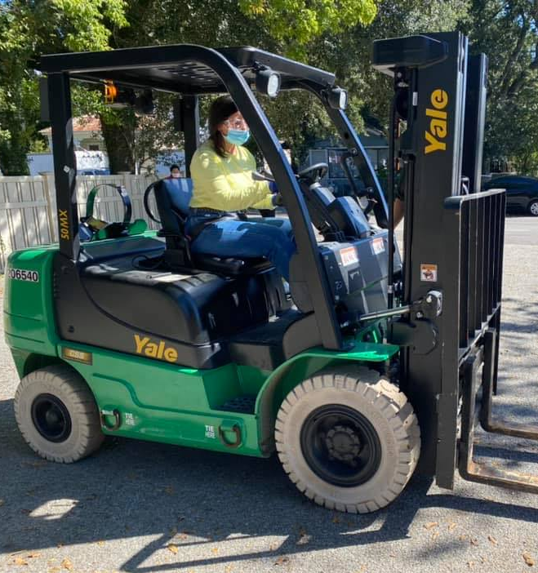
WOMEN IN TRADES 101
SCHEDULE
2 WEEKS
MON.
8:00AM
-
2:00PM
TUES.
8:00AM
-
2:00PM
WED.
8:00AM
-
2:00PM
THURS.
8:00AM
-
2:00PM
FRI.
Personal Development Day
CURRICULUM SNAPSHOT
History of
Women in Trades
OSHA 10hr
Construction
Heavy Equipment Operator Card
COVID-19 ADAPTATION
Hybrid class format
Limited class sizes

Slide 11
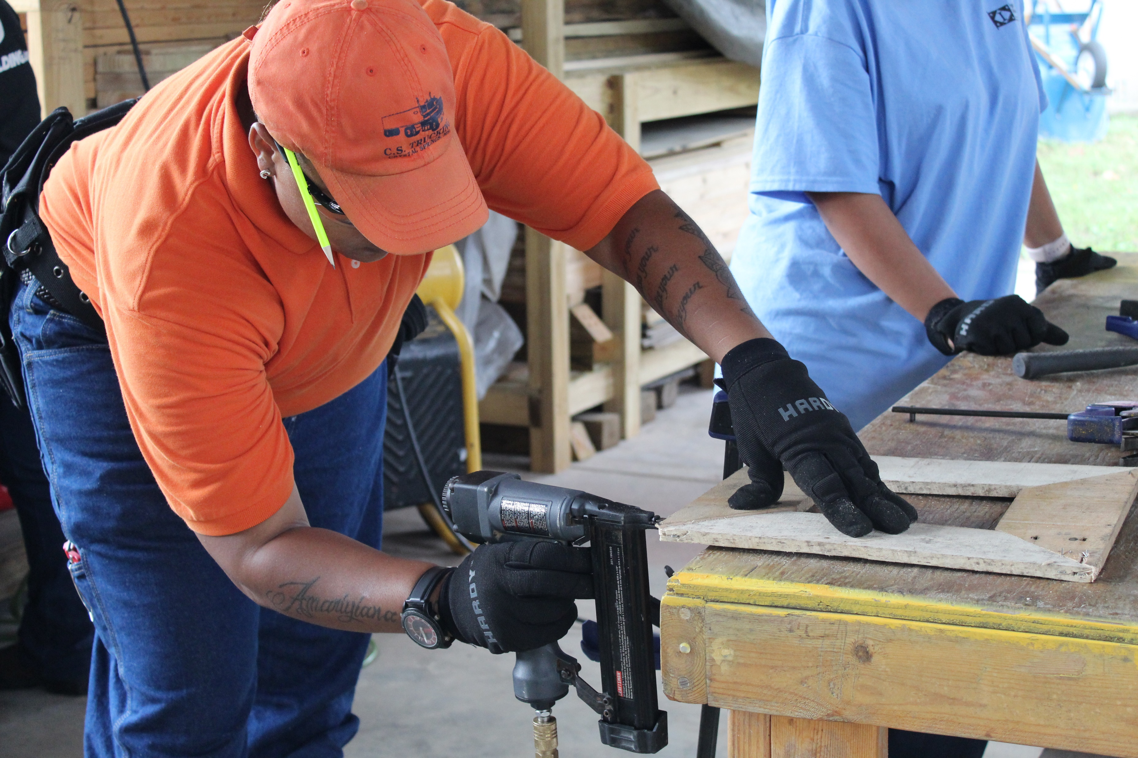
GENERAL INDUSTRY PRE-APPRENTICESHIP PROGRAM
SCHEDULE
7 WEEKS
MON.
8:00AM
-
5:00PM
TUES.
8:00AM
-
5:00PM
WED.
8:00AM
-
5:00PM
THURS.
8:00AM
-
5:00PM
FRI.
Personal Development Day
CURRICULUM SNAPSHOT
NCCER
Core Curriculum
OSHA 10hr General Industry
Supplemental Curriculum
COVID-19 ADAPTATION
Hybrid class format
Limited class sizes

Slide 12
PARTNER TRAINING
Partnerships currently include MGCCC & Ingalls Shipbuilding
Various craft training: Shipfitting, Welding, Pipefitting, Sheetmetal, Machinist, etc.
WinC provides supportive services, so women - who are mostly mothers - can participate in training
Schedules vary

Slide 13
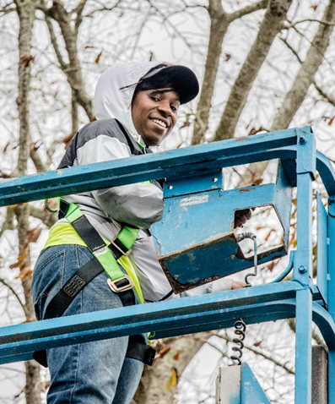
ADVANCED LEADERSHIP
Offered to WinC General Industry graduates
Various advanced credentials may include: OSHA 30hr Construction/General Industry, additional Heavy Equipment Operator Cards, additional NCCER credentials
WinC provides supportive services, so women - who are mostly mothers - can participate in training
Schedules vary

Slide 14
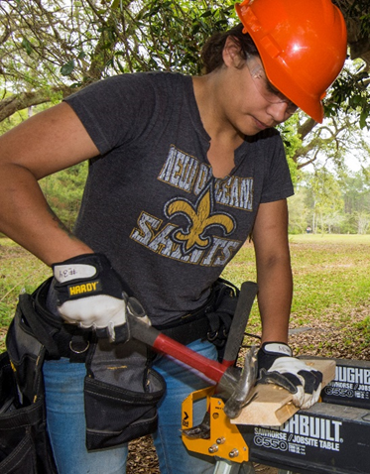
QUALIFICATIONS FOR WINC
18 years of age or older
Eligible to work in the United States
Seeking a career in the trades; Willing and able to perform manual labor 8+ hours/day
Priority acceptance given to:
Individuals whose income is at or below 200% of the federal poverty level
Primary caregivers to a child 13-years-old or younger OR someone over 13 with a disability

Slide 15
ENROLLMENT PROCESS
INFORMATION SESSION
CALL-BACKS
ASSESSMENTS
REGISTER VIA WEBSITE
Due to COVID-19, the WinC enrollment process is currently virtual.

Slide 16
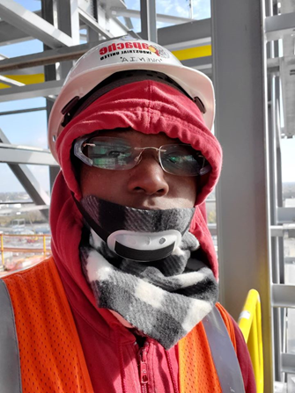
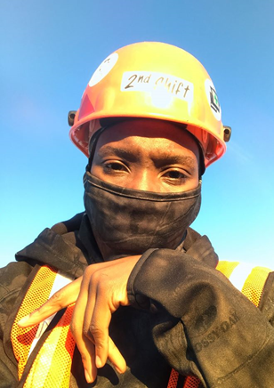
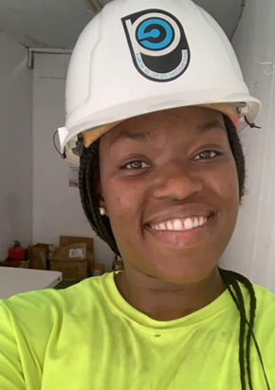
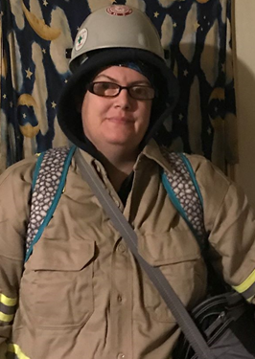
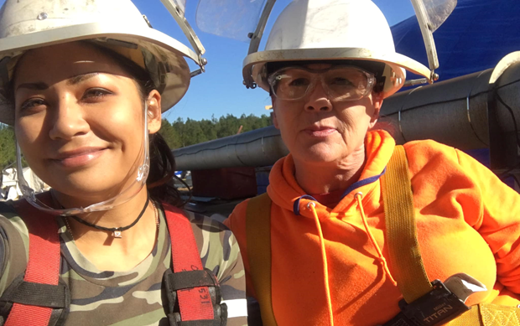
SUCCESS & PLACEMENT
WOMEN GRADUATED: 700+ | GRADUATION RATE: 78% | PLACEMENT RATE: 74%
GRADUATE OPPORTUNITIES: Ingalls Shipbuilding, VT Halter Marine, Bernhard MCC, IBEW (Electrical Union), UBC (Carpenter’s Union), Residential & Commercial Contractors, Habitat for Humanity, Walmart & Amazon Warehouses, Small Business Owners

Slide 17
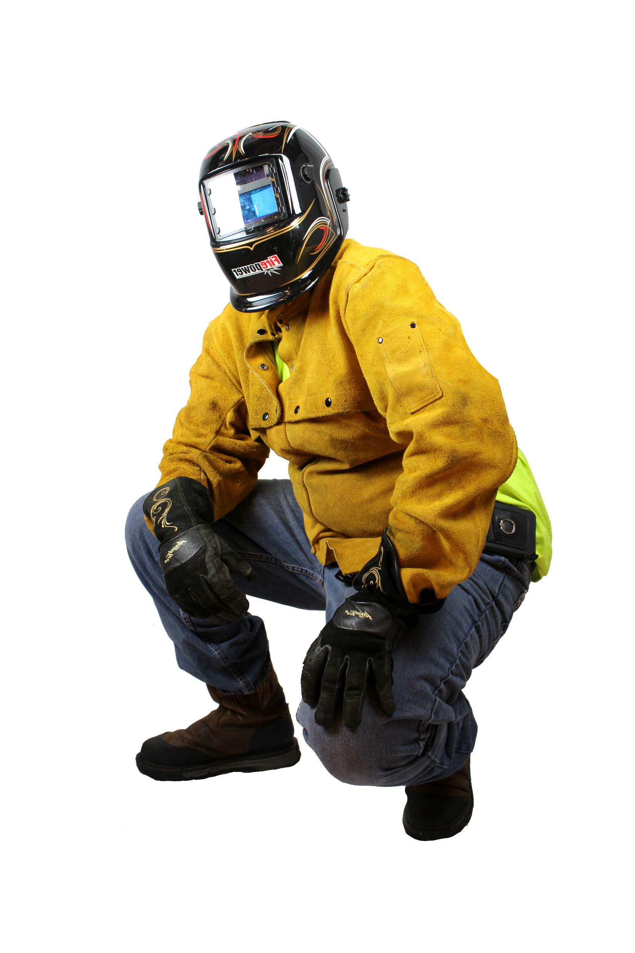
Women in Construction is helping Mississippi to develop our workforce and meet employer needs in order to support economic growth and self-sufficiency.

Slide 18
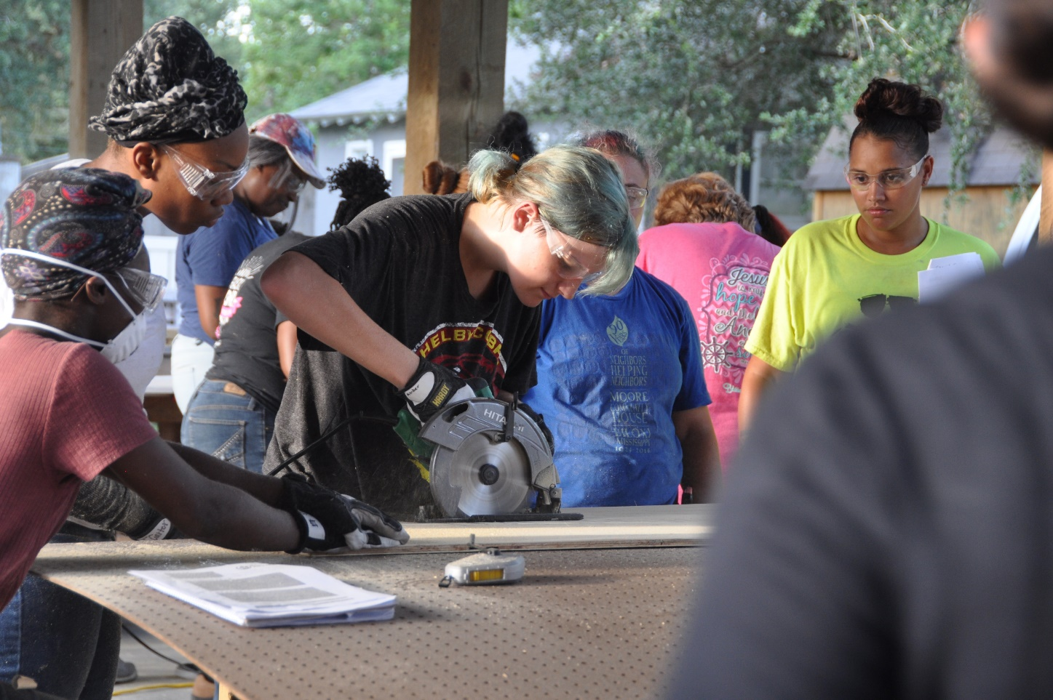
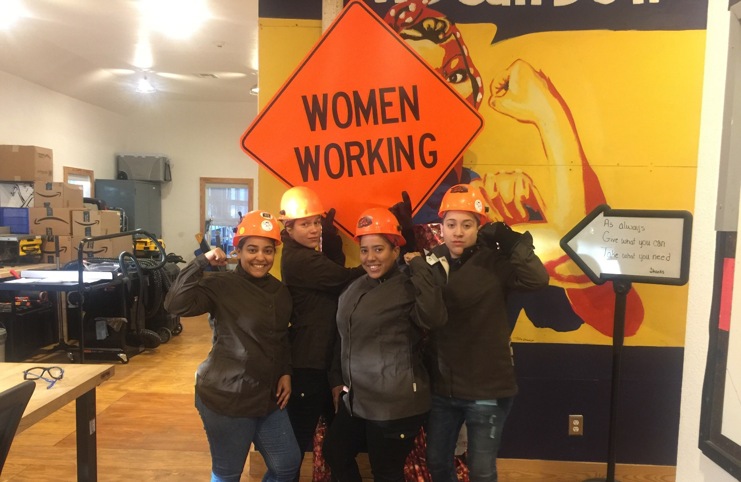
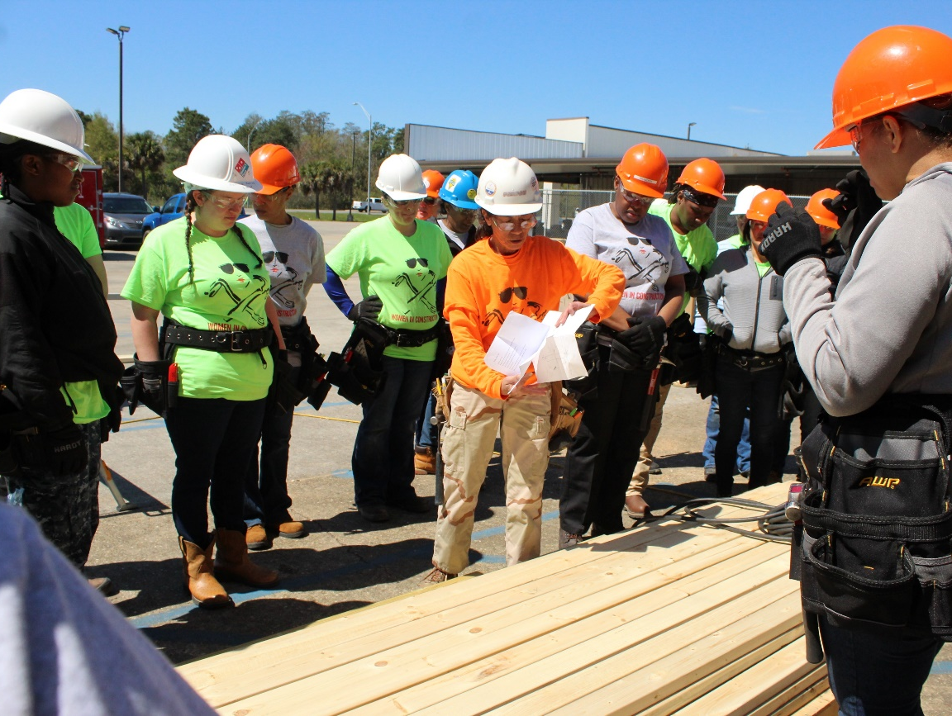
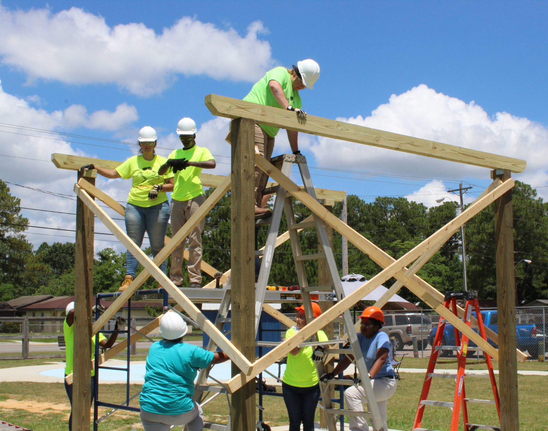
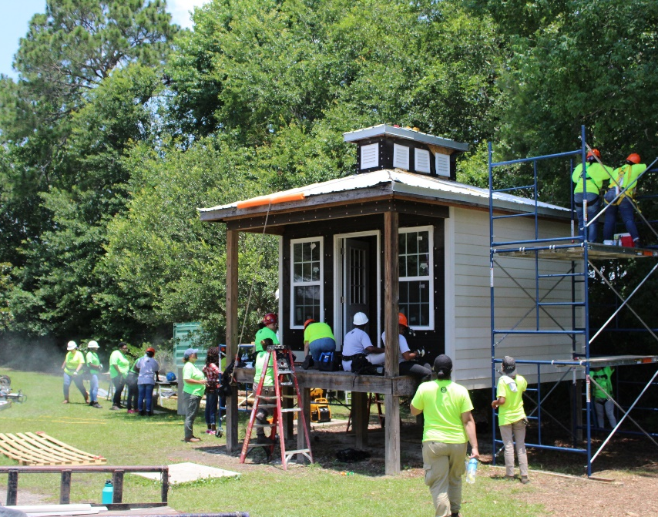

Slide 19
FOR MORE INFORMATION
CONTACT US:
Moore Community House - Women in Construction Program
684 Walker Street
Biloxi, MS 39530
www.moorecommunityhouse.org/winc
www.facebook.com/MCHWomeninConstruction
Carol Burnett| Executive Director
cburnett@moorecommunityhouse.org
Ruth Mazara| Program Director
ruth.winc@moorecommunityhouse.org

